Slide 1
Prediction of disease from symptoms with different models
Kolluru chandana-16338510
Rohan Kumar Bitukunti- 16338416
Sandeep Gooda – 16325948
Afroz Shaik - 16325864

Slide 2
Objective
The main objective of the project is to develop a model which can take the symptoms as input from the user and predict the disease with the Machine learning algorithms which can used as first step in diagnosis.
To detect the disease with the multiple algorithms at the same time for the same symptoms from the user since symptoms vary from person to person for the same disease.
To obtain higher accuracy in detecting the disease for each algorithm used.
To create a user interface for user into the symptoms for the ML algorithms to detect the disease and provide option for the user to choose the algorithm of their choice for detection.

Slide 3
Introduction
With the increase of the patient data in the present situation it is difficult to track all the data and analyze, so here as one of method for analysis we are using the machine learning algorithms in our project.
In this project we are taking the data for the disease and symptoms in a csv file.
We are using this data with a ML algorithms to predict the disease with the help of gui for the user to input the symptoms.
Multiple models are used in this project because for the same disease users might not have same symptoms, they vary from person to person.
The motivation for the development of this project is many people may not access to diagnosis centers all the times so as a first step of diagnosis people can this interface and make lives easy by predicting the disease and taking necessary precautions.

Slide 4
Technical specifications:
In this project we have use
Tkinter – to build the python gui
NumPy – used for computing and array processing
Pandas – It is used for data analysis
Sklearn- It is used for pre-processing, cross-validation and visualization techniques.
Decision Tree Algorithm
Random forest Algorithm
Naïve Bayes algorithm

Slide 5
Existing system:
In the existing system we can predicted one disease with the data using machine learning algorithms.
The prediction is not always accurate in the existing system.
Proposed system:
In the proposed system we are trying to predict multiple diseases with the symptoms as input from the user.
However not all users have same symptoms from a disease so here we are using multiple algorithms to predict the disease.

Slide 6
Approach
Flow diagram of design and approach of model.
Data gathering
Data cleaning
Model for algorithms
In depth study of algorithms used
Predictions and results
Building the GUI or website

Slide 7
Implementation
The data set contains the data in 0’s and 1’s so we need to clean the dataset to remove all the null vales.
Now we convert the labels in the data to numerical format and split the data for training and testing .For training we are training we are taking 80% data and for testing we are taking 20%.
Now in building the model we are using K-fold cross validation technique.
For cross validation we are using the machine learning algorithms like Decision Tree, Random Forest, Naïve Bayes classifier.
A python GUI is built to pass the symptoms from the users and predict the disease with the Machine learning algorithms.

Slide 8
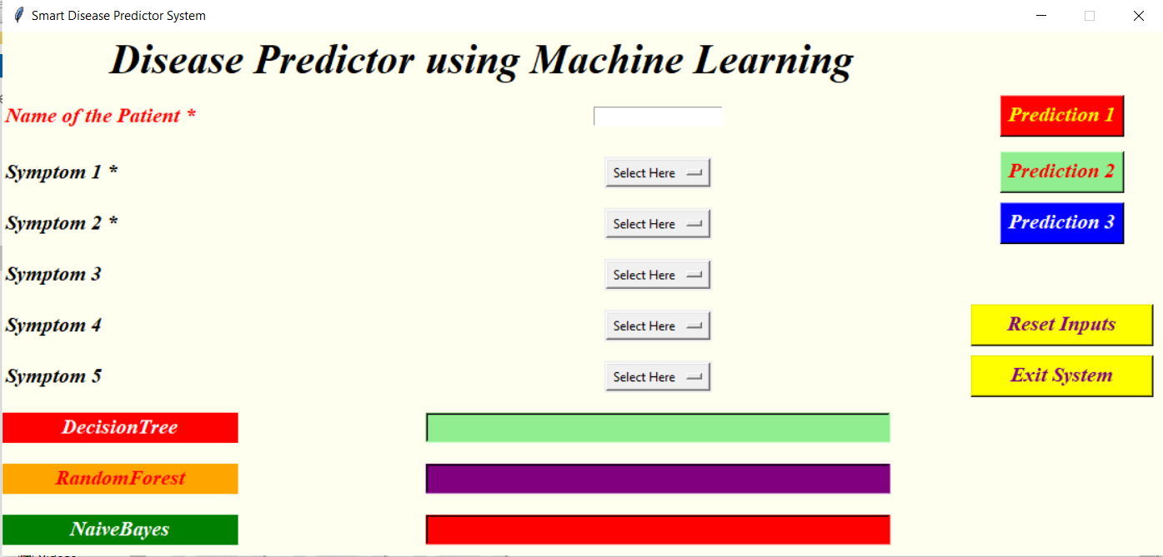
Python GUI

Slide 9
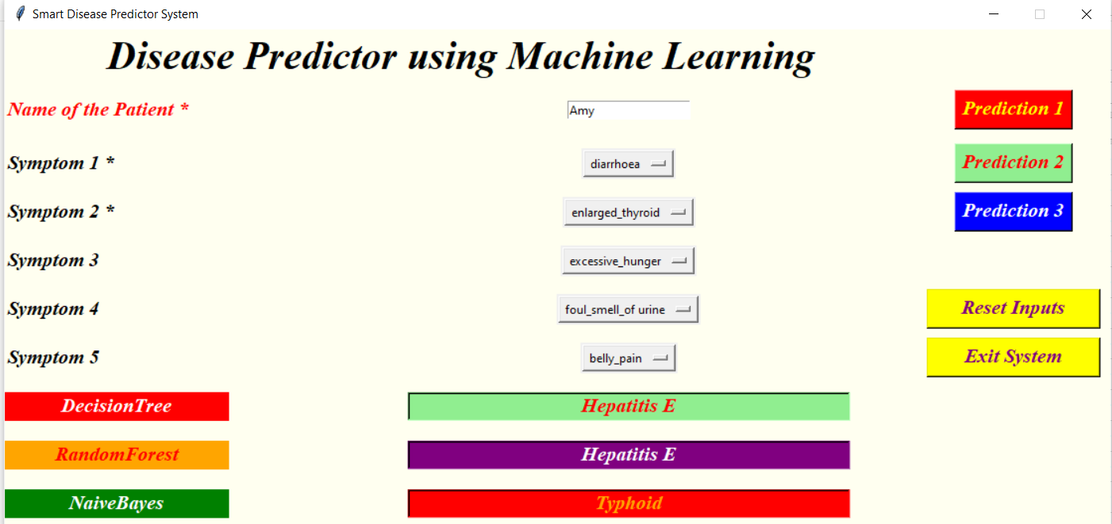
Results
To measure the performance evaluation we are using the confusion matrix and accuracy of the model.
A successful disease prediction from the GUI

Slide 10
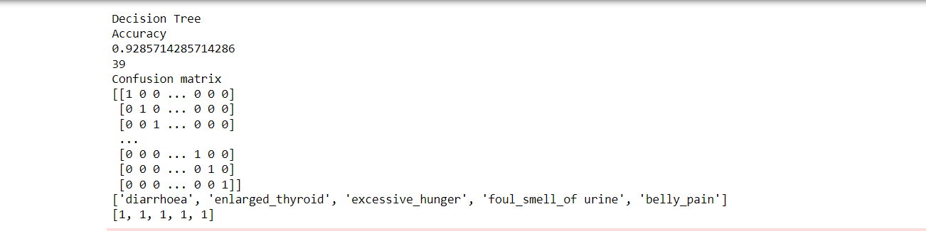
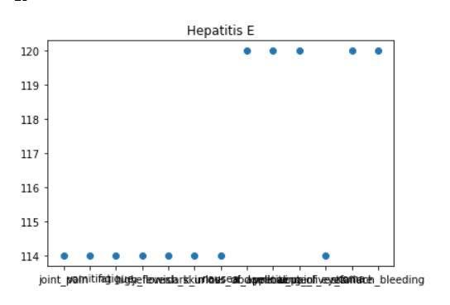
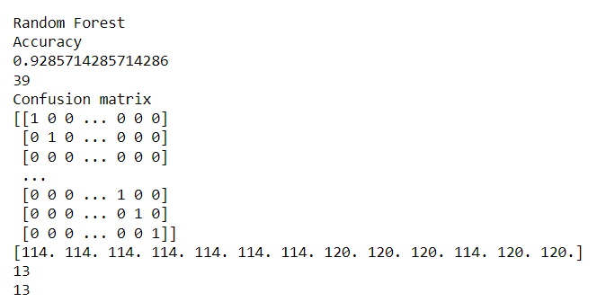
Analysis
After we analyze the algorithms we will be getting the results and accuracy for each classifier.

Slide 11
Challenges
Since the dataset is huge it took more time for cleaning the unwanted data.
The GUI built is specific for this project, so a few challenges were faced since the entire GUI is hard code.
Choosing the Classifiers among all the ML classifiers available is a hard task.
Improving the accuracy for the selected classifier is time consuming.

Slide 12
Future work
Present model we are using only 3 algorithms for the prediction of disease, but in the future we plan to give the user an option to select the drop down from the list of n- number of classifiers to choose for prediction.
Improve the accuracy of the current model to the maximum.
We also plan to add more diseases and symptoms to the model.

Slide 13
Conclusion
We were able to achieve the 93% accuracy on an average.
With a system like this people who do not have an access to diagnosis center can find the disease and take the precautionary steps as first step pf treatment.
We have included method for storing the user input which can be used in the future to build a better version .
We were also able to see how different supervised machine learning algorithms work and were analyzed as well. It provided insight into how technologies such as machine learning can help the healthcare industry.

